Slide 1
Risk mapping and implementation of a risk management application in Gabon
Armel NZUE MBA
Head of Priority Thematic Service
Gabonese Agency for Space Studies and Observations

Slide 2
Outline
(Use the titles below where applicable)
Short presentation of the priority thematic service
Introduction/Background
Global Methodology
Results
Prospects

Slide 3
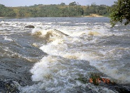
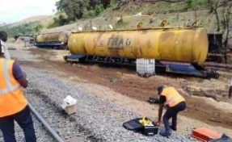
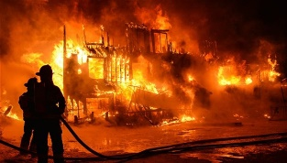
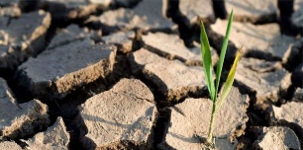
Priority thematic Service
1
6
WATER RESOURCES
URBAN
1
6
2
5
AGRICUTURE
INFRASTRUCTURES
2
5
3
RISKS
4
MINING
3
4
7
CLIMAT CHANGE

Slide 4
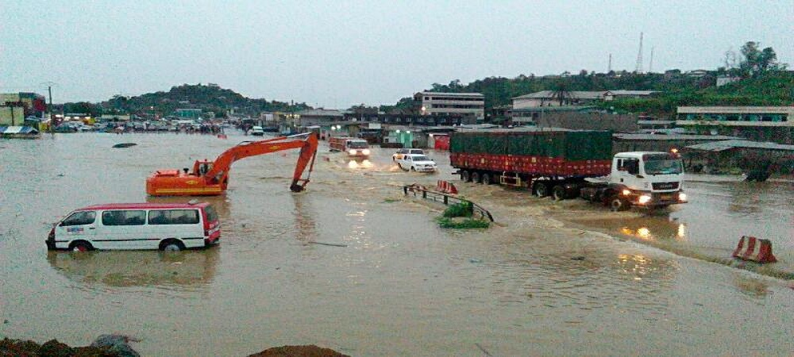
Introduction/Background
Every year Gabonese cities are subject to flooding
In Gabon, nearly 87% of the population lives in urban areas, which represent only 1.1% of the national territory, resulting in enormous pressure on urban areas. The country's main cities are experiencing many problems related to this strong demographic pressure, including greater exposure to natural hazards (floods, landslides ...).

Slide 5
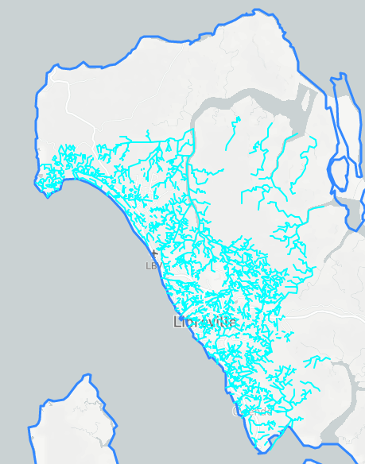
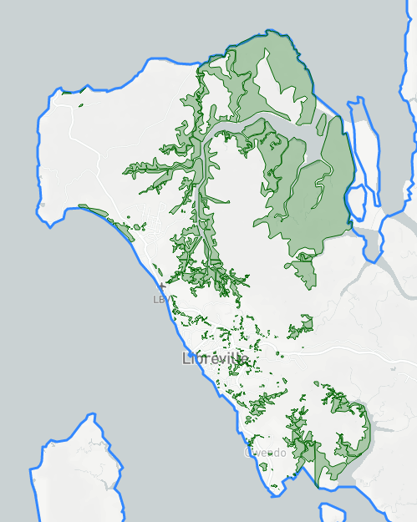
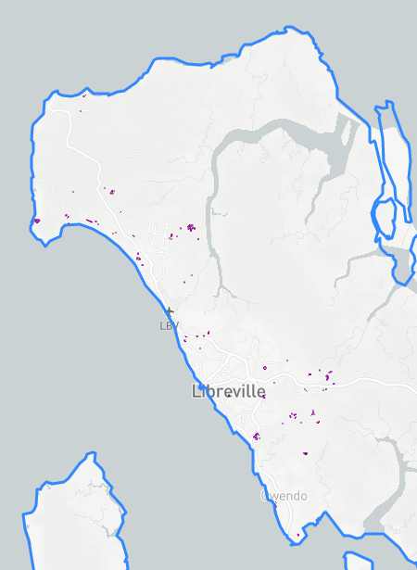
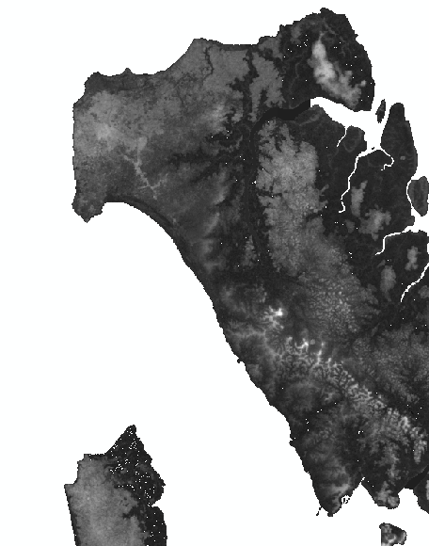
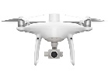
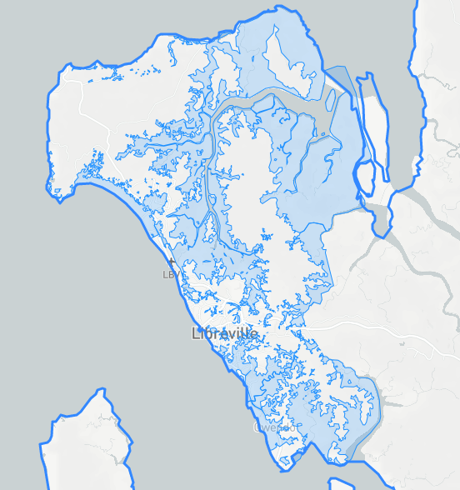
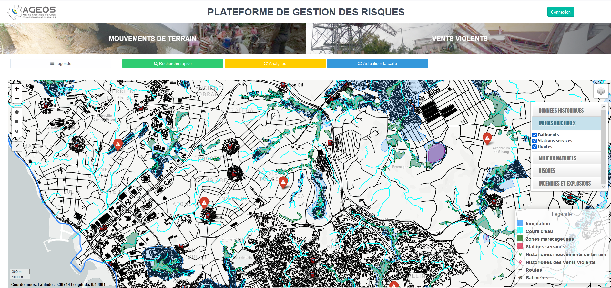
Methodology (Data & Methods), Implementation Plan/Activities
Water course Wetlands Water plan Topography (elevetions)
historical data
DATA COLLECTION AND PRODUCTION
Infrastructures
A
FLOOD MAPPING BY MULTI-CRITERIA ANALYSIS
B
DEVELOPMENT OF THE RISK MANAGEMENT APPLICATION
C
IMPLEMENTATION OF ALL DATA ON THE APPLICATION
Bulletins d’information, Rapports, Outils en ligne…
D
TEST PHASE FOR THE FUNCTIONING OF THE APPLICATION
E

Slide 6
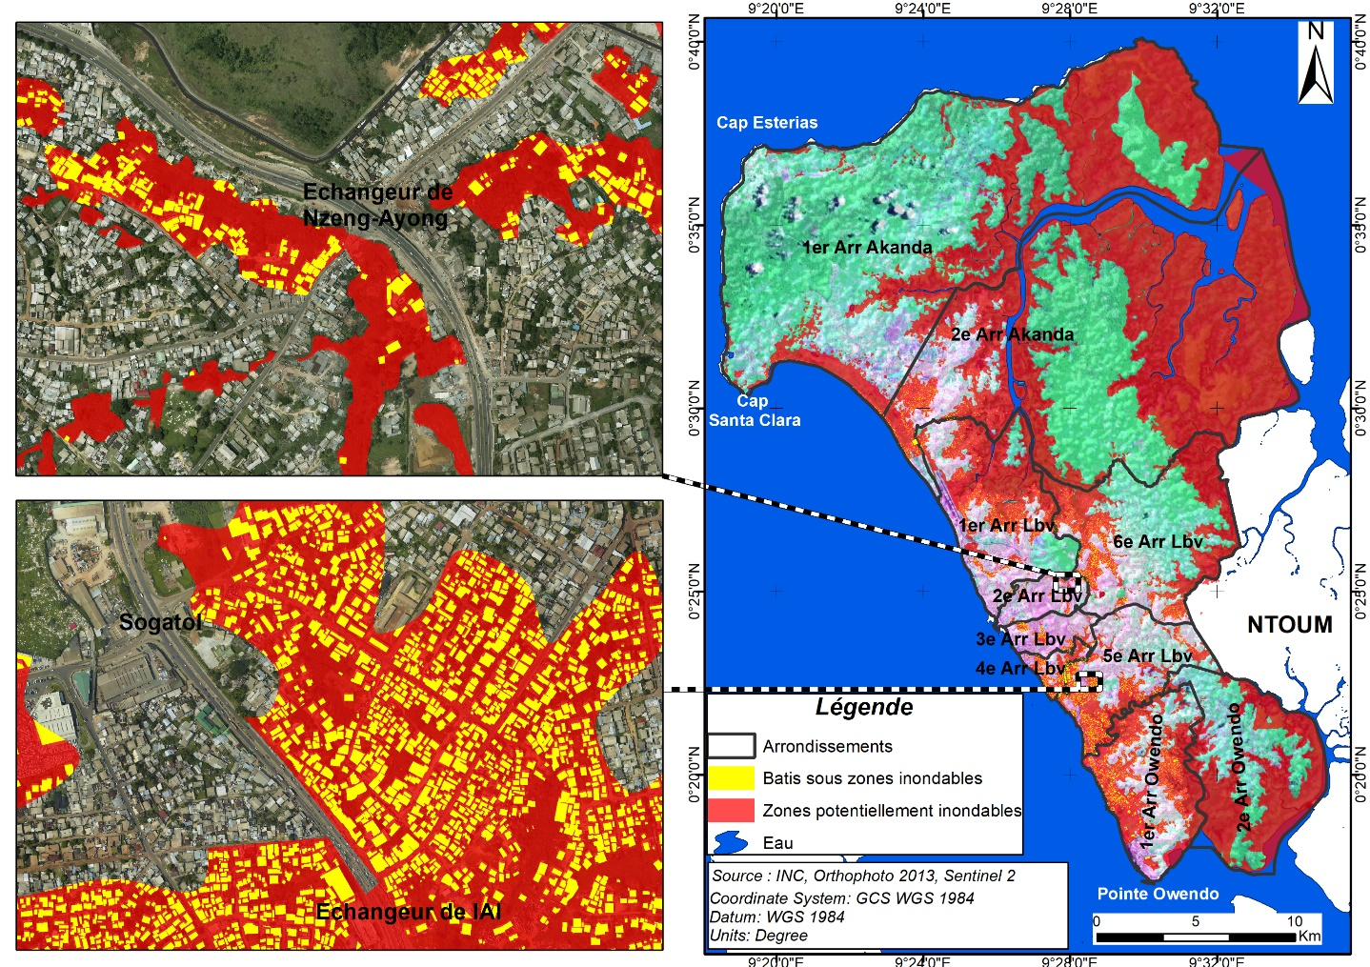
Final or Preliminary Results/Outputs
Total surface potentially floodable (ha) | Number of buildings potentially liable to flooding
31952 | 17522

Slide 7
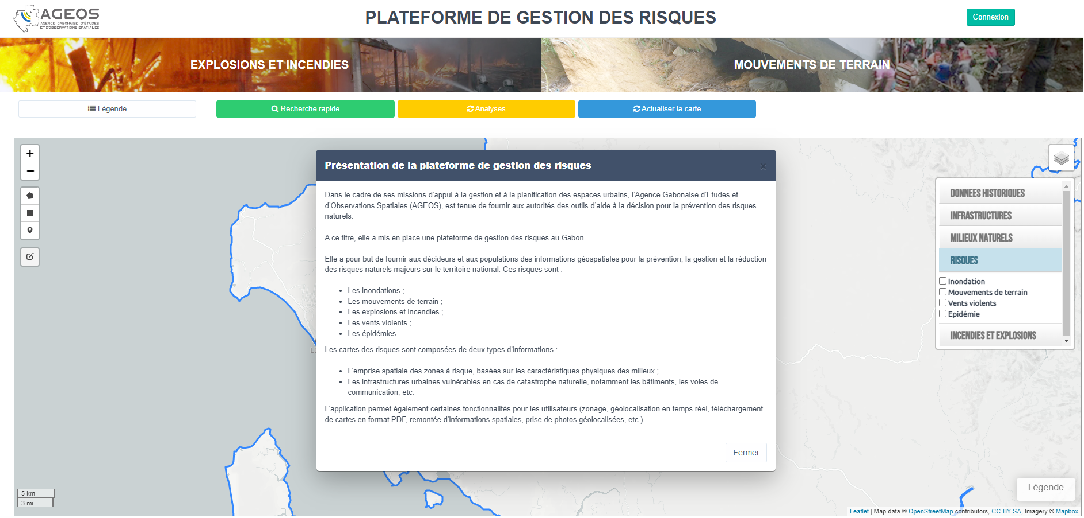
Expected/proposed application areas of the research/product/tool/service
Risk management application
https://apps.ageos.ga/web_services_inondations/

Slide 8
Conclusion/Expected Outcomes
Mapping all risks across the country;
Setting up an early warning system;
Set up a mobile for data collection.

Slide 9
Collaborators, Stakeholders and Users
Ministry of the Interior
Gabon Red Cross
Populations

Slide 10
Thank you
Questions?

